Slide 1
SOCIAL CARE- CRISIS AND SOLUTIONS
Brian Fisher
Vice-President SHA
Lewisham SCAG
Reclaim Social Care

Slide 2
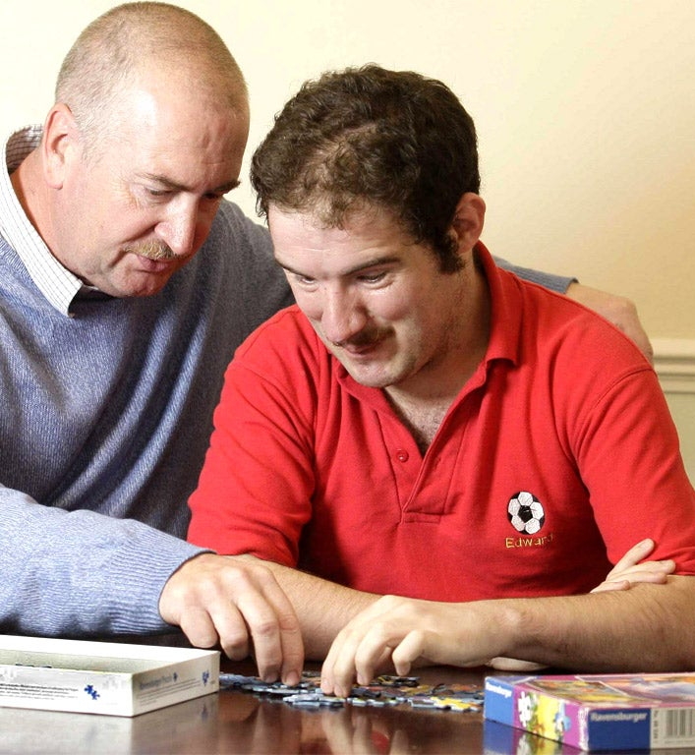
AGENDA
Campaigning – who we are
Definitions – social care
Austerity
Privatisation
Workforce
Policy options
Fightback

Slide 3
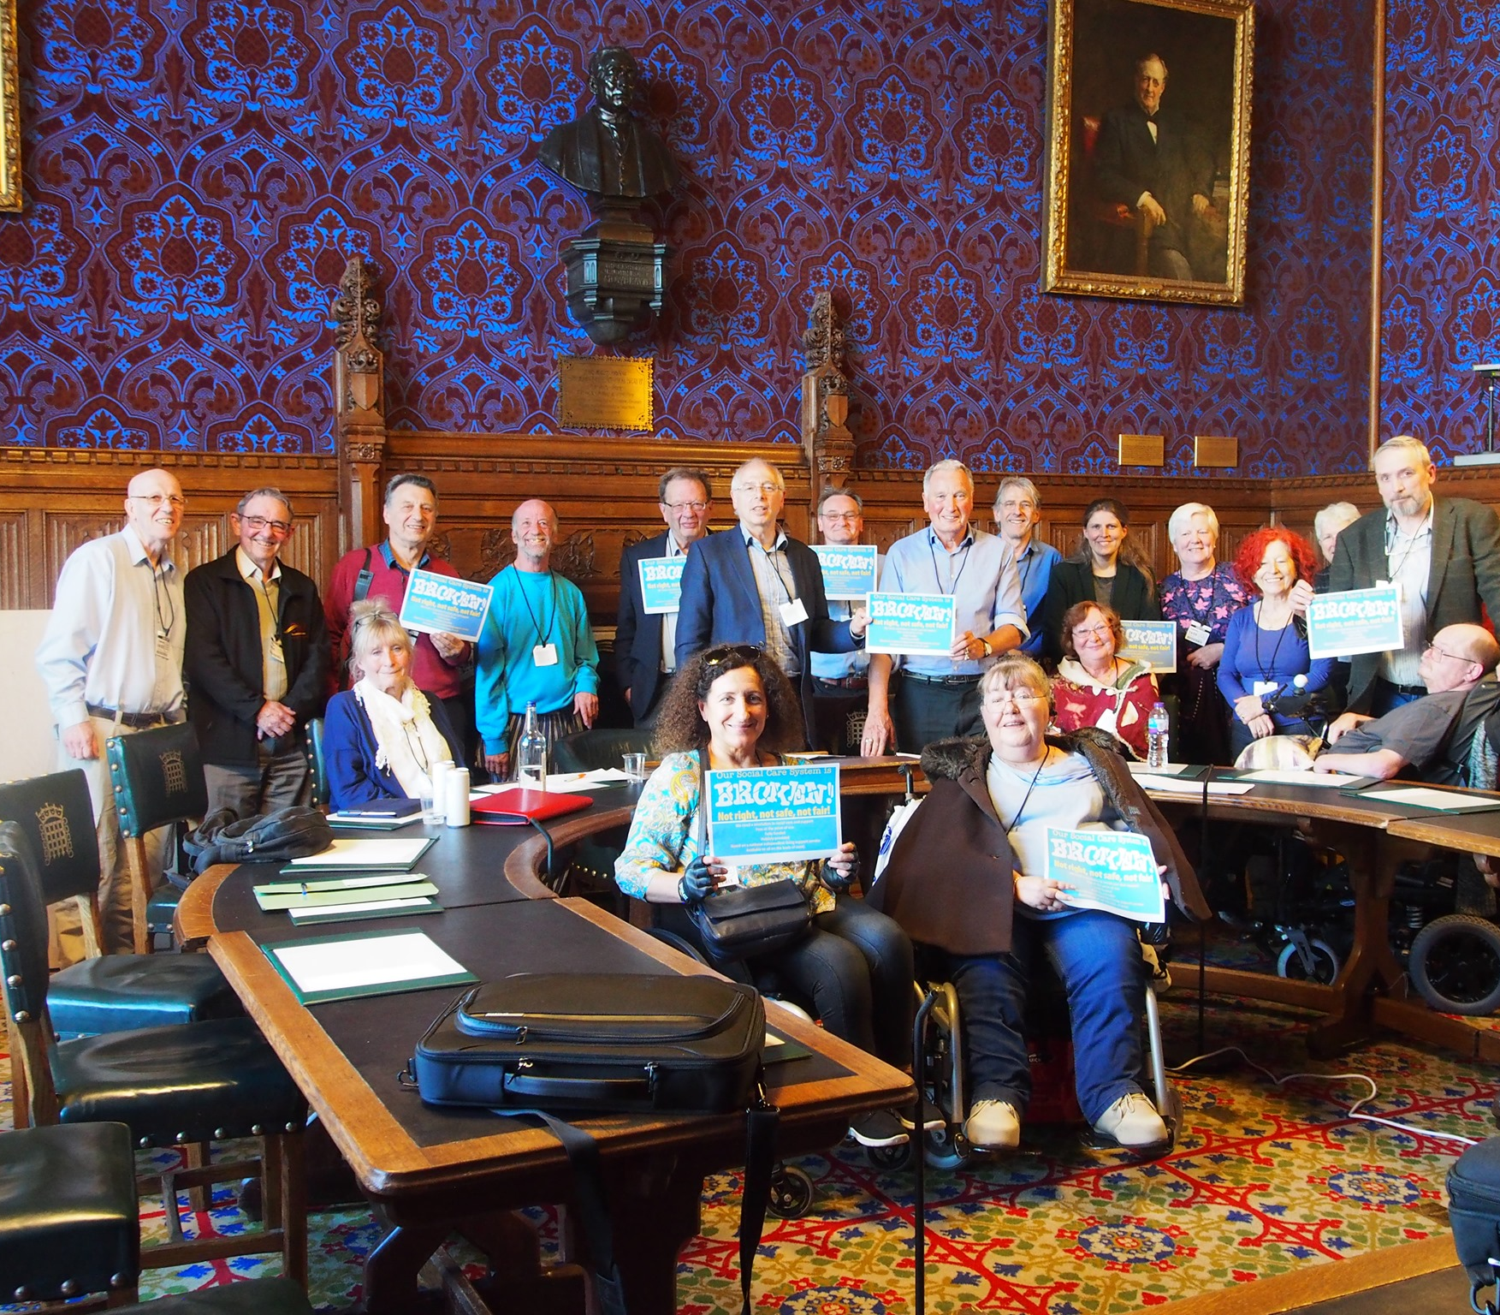
RECLAIM SOCIAL CARE
National campaign
Disabled people, carers, academics, managers, SHA , NPC, unions
2 aims:
Challenge the cuts in care and support
Shift Labour Party policy on social care and support
Hosted under Health Campaigns Together

Slide 4
DEFINITIONS

Slide 5
WHAT IS SOCIAL CARE?
Social work, personal care, protection or social support services to children or adults in need or at risk, or adults with needs arising from illness, disability, old age or poverty. It includes younger adults with physical or learning disabilities or mental health issues, as well as older people.
Domiciliary care – people living at home and receiving care to meet needs and /or support independent living.
Residential care – people living in a care home
Social care is paid for either privately or from non-ring-fenced local authority budgets, with councils retaining discretion over spend

Slide 6
NHS CONTINUING CARE
For people with healthcare needs related to the treatment, control or prevention of a disease, injury or disability and the care and aftercare of a person with these needs
NHS continuing care is paid for out of general taxation and operates within a ring-fenced budget
Difference between social care and continuing care is unclear and leads to inequalities e.g. dementia care

Slide 7
HOW PEOPLE PAY FOR SOCIAL CARE
Full care funding is available only to people with assets of less than £14,250
Part-funding is available to those with assets above this but less than £23,250
For nursing and residential care, ‘assets’ are considered in the value of their home but not for homecare
The Commission on Funding of Care and Support estimated that 1 in 10 people faced lifetime care costs of £100,000
In Scotland free personal and nursing care has been available since 2002

Slide 8
AUSTERITY

Slide 9
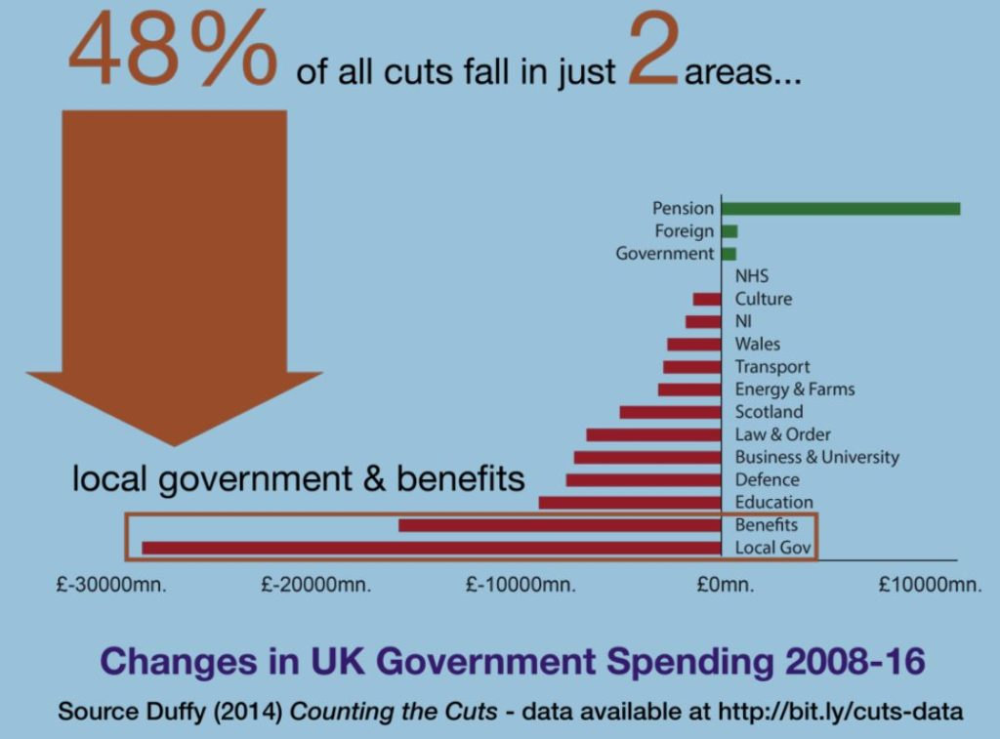
60% CUTS TO SOCIAL CARE NATIONALLY
£7 billion slashed from LAs since 2010
Local Authorities face £700m cuts in 2018-19
Local Authorities are £2.3 billion short to maintain services this year.
54% of total budgets now spent on Adult and Children’s Social Care – more in some councils
33% reduction in all other services

Slide 10
THE IMPACT
26% fewer older people receiving support since 2010
1.2 million older people have care needs unmet.
The number of people 65+ will grow by 20% over10 years.
Tighter eligibility criteria for help at home
Nursing care beds have reduced
Fewer people get financial support for residential care.
UN: UK Gov has committed “grave” and “systematic” violations of disabled people’s human rights.

Slide 11
CUTS IN LEWISHAM
LA Budget fell from £406m in 2010 to £241m by 2018.
£30m further cuts planned 2019 – 21
Overall workforce cut by 50% (5,000 to 2,500 staff)
Over £20 million lost to Adult Social Care
46% of total budget now spent on Adult and Children’s Social Care, with big overspend on Children’s Services (18-19)

Slide 12
ECONOMIC VALUE OF SOCIAL CARE
£38.5 billion contribution to economy in England
£5.2 billion in London
£210 million in Lewisham

Slide 13
PRIVATISATION

Slide 14
PRIVATE SECTOR CARE HOMES
Difference between large and small care homes.
In state-funded home-care services the private sector provided
5% in 1993.
89% by 2012
Large care home chains extract cash
Recurrent crises - chains bought and sold using debt leveraged buyouts
sale prices are inflated
chains are loaded with ever more debt
cash flow cannot cover the financing cost.
High and risk-free returns with 12% rate of return on capital.
http://hummedia.manchester.ac.uk/institutes/cresc/research/WDTMG%20FINAL%20-01-3-2016.pdf

Slide 15
THE PRIVATE SECTOR AND COMPETITION
Lesson one: The take over of state-funded social care services was rapid
Lesson two: Reducing costs reduces quality of services
Lesson three: Reducing costs has led to the de-regulation and casualisation of the social care workforce
Lesson four: Provider failure is an inevitable consequence of any care market, with significant implications for patients, care users and their families - 58% increase in private providers leaving the care market in the last year
https://chpi.org.uk/wp-content/uploads/2013/10/CHPI-Lessons-from-the-social-care-market-October-2013.pdf

Slide 16
WORKFORCE

Slide 17
ENGLAND
1.34 million workers now…2 million needed by 2035
82% women
83% British (70% London)
4% EU 82% BAME in Lewisham
20% over 55
8% vacancy rate – mostly care jobs
Turnover rate of 31% in 2017-18
Only 2% jobs created each year

Slide 18
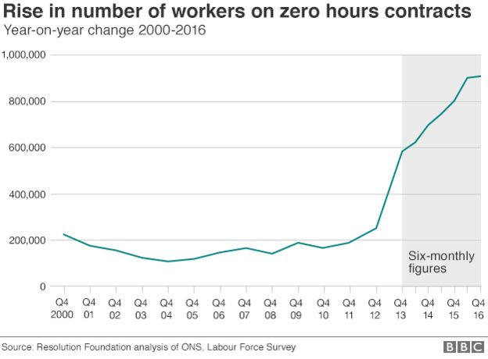
CONDITIONS OF WORK - LEWISHAM
46% on zero hours contracts (25% England)
46% full-time (51% England)
Care worker pay = £8.92
(London Living Wage = £10.55)

Slide 19
UNISON’S ETHICAL CARE CHARTER
Principle of quality employment for a quality service
Adopted by Lewisham and 44 other councils/providers
Requires payment of London Living Wage
End to zero hours contracts…
Statutory sick pay
Payment for travel time between visits
End to 15-minute visits
Provision of training
Is Lewisham complying?

Slide 20
POLICY

Slide 21
LABOUR’S POLICY ON SOCIAL CARE
National Care Service for England, alongside the NHS,
single commissioning, partnership arrangements, pooled budgets and joint working arrangements.
Increase of £8 billion over next Parliament
a maximum limit on lifetime personal contributions to care costs,
raise the asset threshold below which people are entitled to state support,
and provide free end of life care.
Increase Carer’s Allowance for unpaid full-time carers
Extra £350 million a year for autistic people and people with LD to live in community.
£350m on training for social care workforce

Slide 22
SHA POLICY 1
Conference demands Labour legislates a duty on the SoS to provide a universal system of social care and support acknowledging a right to independent living wherever possible:
Based on need and offering choice.
Meeting the needs of all disabled, frail and sick throughout life with robust safeguarding procedures.
Free at the point of use, universally provided, fully funded through progressive taxation
Subject to national standards based on Human Rights, choice, dignity and respect for all, complying with the UN Rights of persons with disabilities, including Articles on Independent Living (19) Highest Attainable Health (25) and Education (24).

Slide 23
SHA POLICY 2
Democratically run services, delivered through local public bodies working co-productively together with users and carers.
Training to nationally agreed qualifications, career structure, pay and conditions.
Gives informal carers strong rights and support, including finances and mental health.
Labour to establish a taskforce involving users and carers/Trade Unions/relevant organisations to deliver the above, including an independent advocate system, and national independent living support service.

Slide 24
WHAT WE MEAN BY FULLY FUNDED
Everyone gets the Social Care they need
The system is universal and free with no means-testing or taxing of disabled people
Disabled people who need Social Care get entitlements that are sufficient to enable them to live as equal citizens
Social Care staff are paid fairly, not exploited nor pushed on to the lowest possible salary
The essential role of family and the wider community is recognised, respected and supported
The system is subject to regular review and is accountable to disabled people, families, staff and the wider communities they serve and can be monitored against human rights standards
Social Care is funded by progressive taxation, on the same basis as other public services, not linked to some hypothecated income stream, which may or may not be adequate over the long-term

Slide 25
THE COST IN ENGLAND OVER 5 YEARS
End means-testing.
£10 billion (current cost of privately purchased care) PLUS
£1 billion (income from charging).
£8 billion for free personal care
Increase support to 2009 levels(a 44% increase)
£6 billion.
Increase salaries by 25% and reduce pay inequalities to 1:3
£5 billion.
The total cost of Adult Social Care in England
£40 billion or 2% of GDP, (not counting savings from better administration or for other public services).

Slide 26
TRANSITION FROM PRIVATE TO PUBLIC PROVISION
Buying out large care companies – book value rather than market value?
How to encourage smaller care companies to become part of a NCS – use franchising model without profit motive or exit from existing contracts?
Future role of voluntary sector as source of innovation – grants not contracts

Slide 27
RELATIONSHIP BETWEEN NHS AND SOCIAL CARE
Current government drive to integrate NHS and LA Social Services
BUT the government has plans for organisational integration through Integrated Care Providers (ICPs) including a Lead Provider, which could be a private sector organisation
No formal integration
Multi-disciplinary working across neighbourhoods coalescing around the person

Slide 28
JOIN US!
THANK YOU FOR LISTENING

